Slide 1
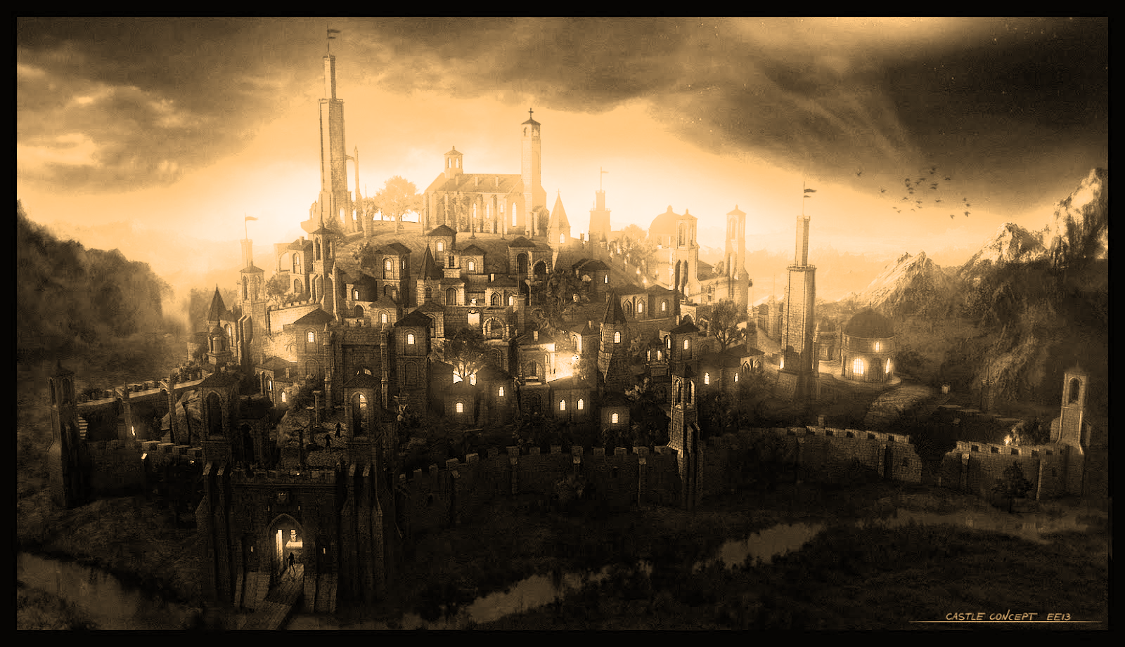
My Adventure Game
Ken Houf

Slide 2
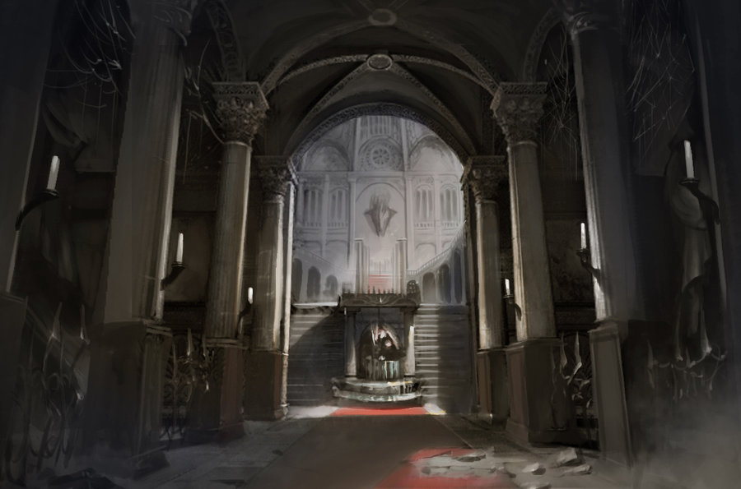



“Groan”
Den
Den
Back

Slide 4
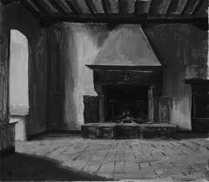

“Groan
next
Back

Slide 5
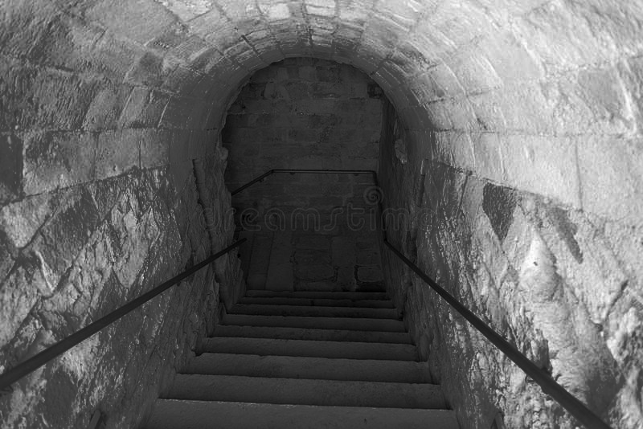

Slide 6
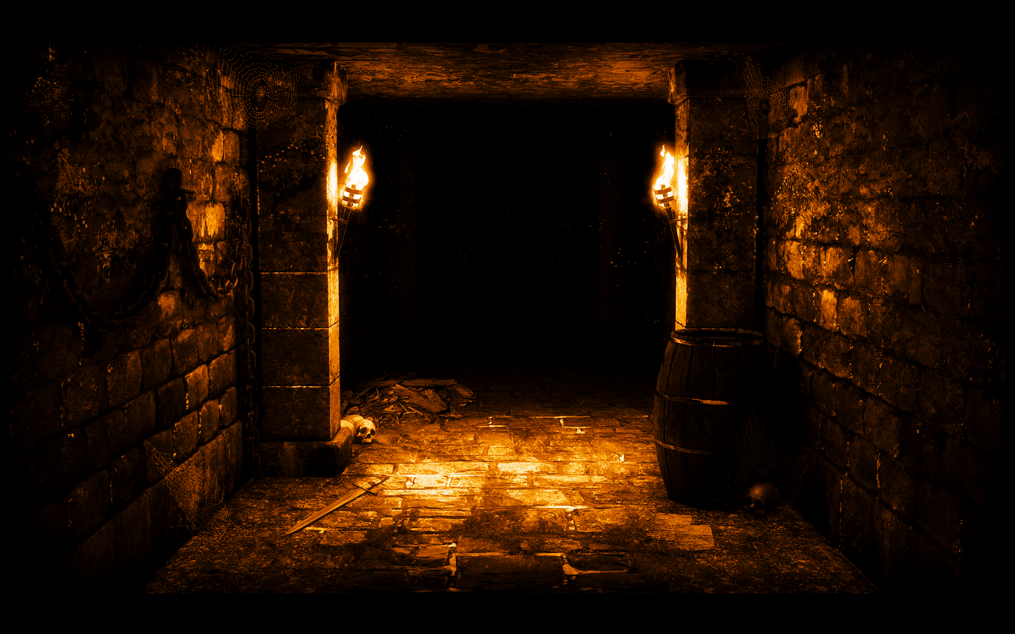
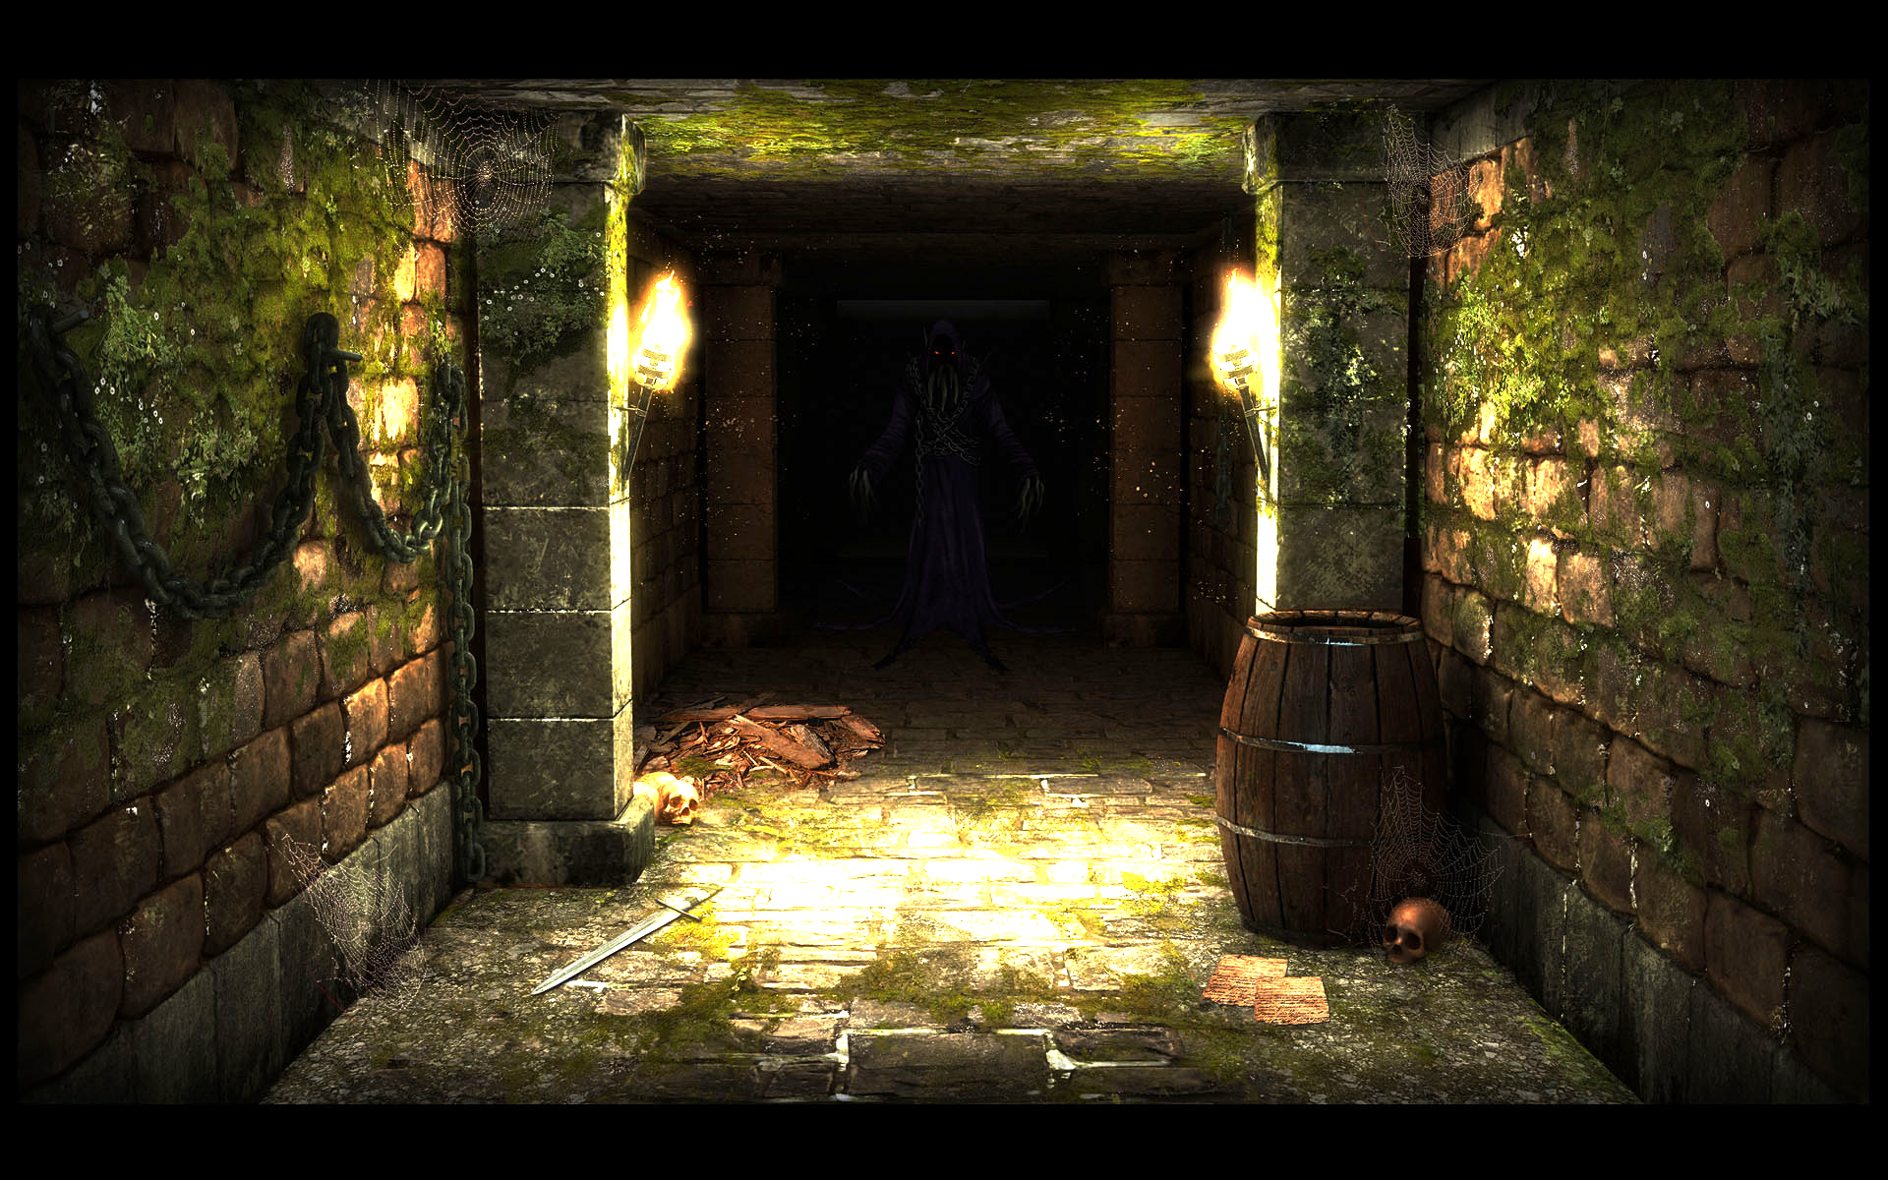
“Groan”
SKREEEEEEEEEEEEEE!!!!!

Slide 7
Game Over

Slide 8
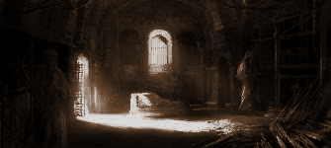
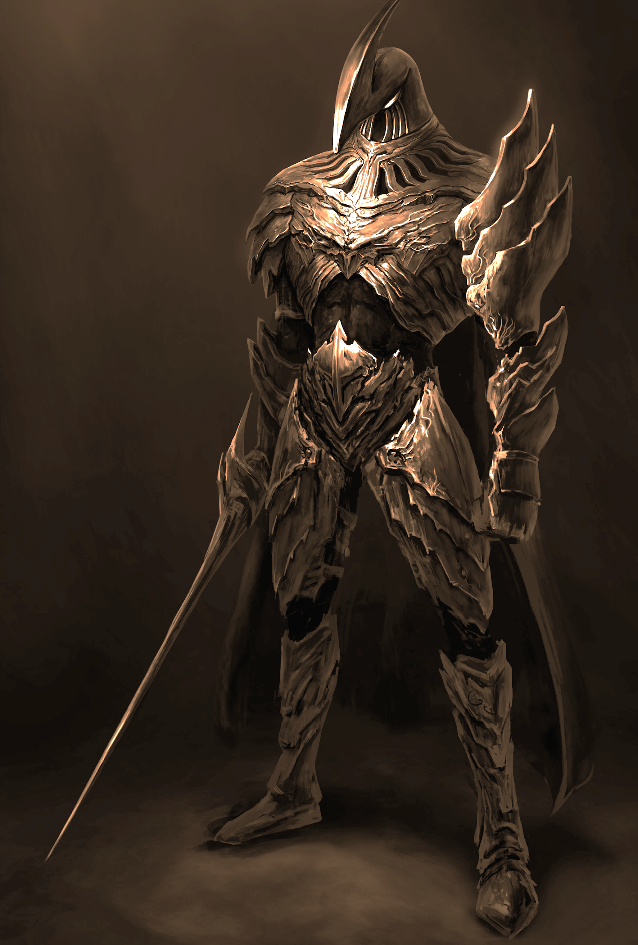
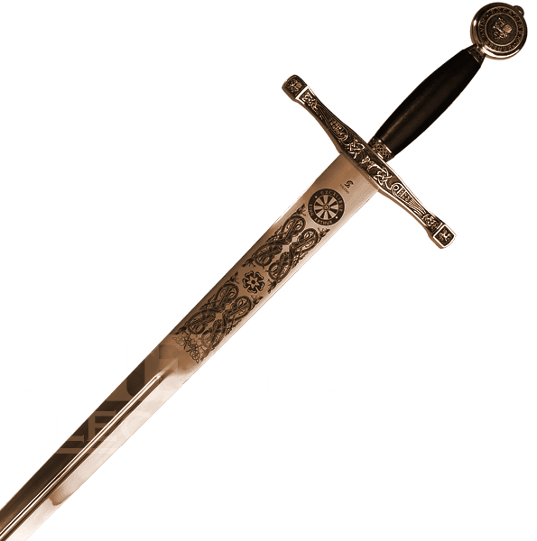
Claim the kingslayer to escape

Slide 9
Congratulations

